Slide 1
Task 1: Web scraping to gain company insights
By: Srinidhi Manikantan

Slide 2
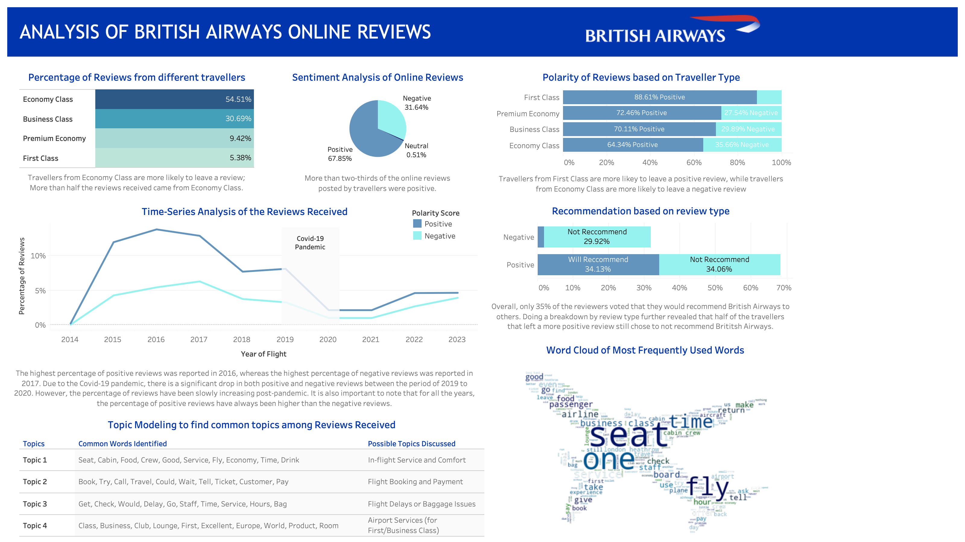

Slide 3
Task 2: Predicting customer buying behaviour
By: Srinidhi Manikantan

Slide 4
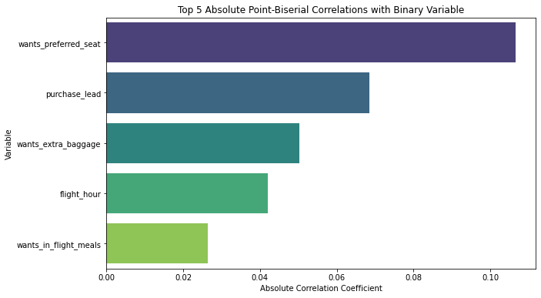
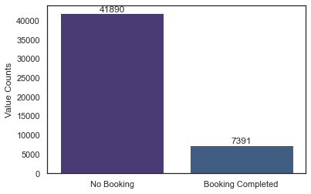
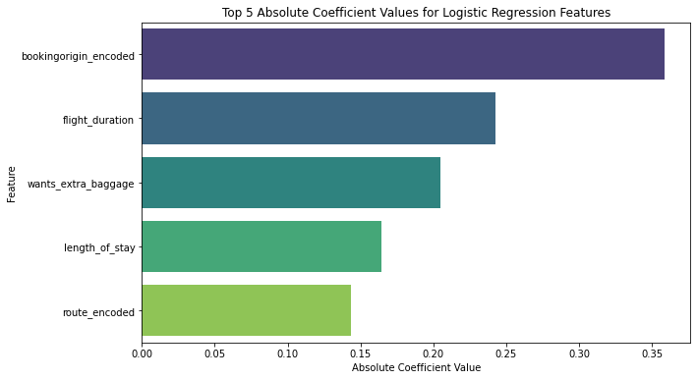
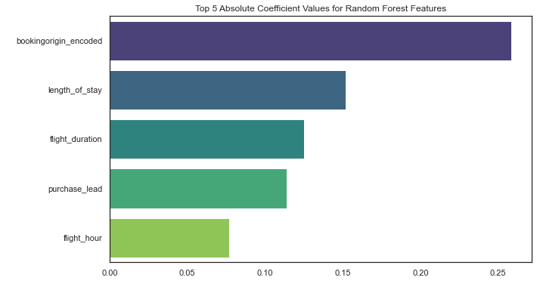
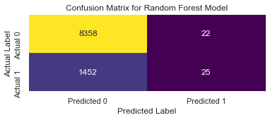
UTILIZING MACHINE LEARNING TO PREDICT CUSTOMER BEHAVIOUR
Exploratory Data Analysis
Distribution of Response Variable
Correlation of Predictor Variables with Response Variable
Original Dataset: 9 numerical + 5 categorical variables, 5000 entries
Checked for missing values, none found
Checked for duplicate values, 719 entries removed
Checked for unique/low variance/correlated variables, none found
Cleaned Dataset: 14 numerical variables, 49,281 entries
Hot-encoded 5 categorical variables to numerical variables
In the cleaned dataset, 85% of the majority class represents “No Booking”, while the remaining 15% belongs to “Booking Completed”. This represents an imbalanced dataset, where one class significantly outnumbers the other.
Since the target variable is binary, Point-Biserial Correlation was used as a correlation metric.
There was no significant correlation identified, and the highest correlation was only 0.10, proving that there is no to very weak associations between the predictor and response variables.
Assessment of ML Models
Finding Important Predictor Variables
Models Used | Accuracy with Cross-Validation | Accuracy with Hyperparam-eter Tuning | F1 Score with Hyperparam-eter Tuning
Logistic (all penalties) | 0.843 | 0.845 | 0.0142
Random Forest | 0.688 | 0.849 | 0.0512
Extra-Trees | 0.806 | 0.850 | 0.0173
Grad Boost | 0.682 | 0.851 | 0.0443
Cross-validation was conducted among 8 different base Machine Learning models (Logistic, RandomForest, ExtraTrees, XgBoost, Decision Tree, GradBoost, CatBoost and LightBGM).
Top 4 models with highest scores were chosen and hyperparameter tuning was performed to further improve the model.
Since there is a significant class imbalance, the model can achieve high accuracy by simply predicting the majority class most of the time, but this is not useful in practice. Hence, F1 score would be more informative, and meaningful since it balances both precision and recall in a single metric.
Random Forest and Grad Boost were the highest performing models. However, the F1 score is significantly low for both models (~0.05) and may not predict the customer buying behaviour accurately in real life.
Using Feature Importance from Logistic Regression and Random Forest, top 3 common features identified are Booking Origin, Length of Stay and Flight Duration.
Limitations and Future Directions
Insufficient Data: The dataset consists of only 5000 entries, which might be insufficient to capture the complexity and diversity of customer behaviours, particularly for a large-scale operation like British Airways with over 40 million customers annually. This may lead to suboptimal model generalization
Consider in additional data collection (features and entries) to significantly increase the size of the dataset
Imbalanced Data: Imbalanced datasets can lead to biased model training, where the model favours the majority class and may not generalize well to the minority class. This may lead to lower precision, recall, and F1 score for that class.
Consider collecting more samples from the underrepresented minority class.

